Slide 1
Introduction: An Overview of Database Management System, Database System vs File System
Lecture 1

Slide 2
DBMS
Database Management System
Term Database requires understanding of data and information

Slide 3
Difference between Data and Information?

Slide 4
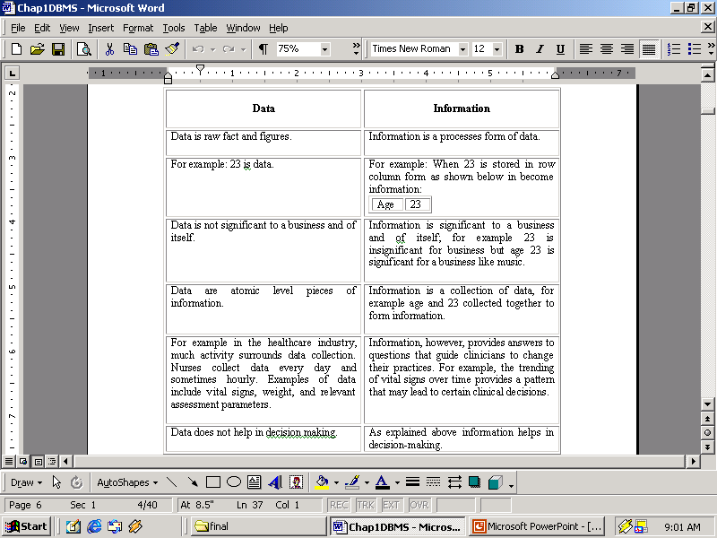

Slide 5
Database
The related information when placed is an organized form makes a database. The organization of data/information is necessary because unorganized information has no meaning.

Slide 6
Operations on Databases
To add new information
To view or retrieve the stored information
To modify or edit the existing information
To remove or delete the unwanted information
Arranging the information in a desired order etc.

Slide 7
Manual database and its problems
Wastage of skills and intelligence of human beings on repetitive calculations.
Error prone.

Slide 8
Database and Computers
•Large storage capacity
•It has high speed
•Computer is more accurate.
There are two approaches for storing data in computers such as File based approach and Database approach.

Slide 9
File Based Approach
File-based systems were an early attempt to computerize the manual filing system that we are all familiar with.
File systems may use a storage device such as a hard disk or CD-ROM and involve maintaining the physical location of the files.
Programmers used programming languages such as COBOL, C++ to write applications that directly accessed flat files to perform data management services and provide information for users.

Slide 10
Limitations of the File-Based Approach
_x0001_ Separated and Isolated Data
Duplication of data _x0001_
Data Dependence _x0001_
Difficulty in representing data from the user’s view _x0001_
Data Inflexibility _x0001_
Incompatible file formats

Slide 11
Database Approach
A database is a computer based record keeping system whose over all purpose is to record and maintain information.
The database is a single, large repository of data, which can be used simultaneously by many departments and users.

Slide 12
Database Management System (DBMS)
DBMS A database management system is the software system that allows users to define, create and maintain a database and provides controlled access to the data.
A database management system (DBMS) is basically a collection of programs that enables users to store, modify, and extract information from a database as per the requirements.

Slide 13
Examples of Database Applications
The following are main examples of database applications:
Computerized library systems
Automated teller machines
Flight reservation systems
Computerized parts inventory systems
Commercially available Database management systems in the market are dbase, Foxpro, IMS and Oracle.

Slide 14
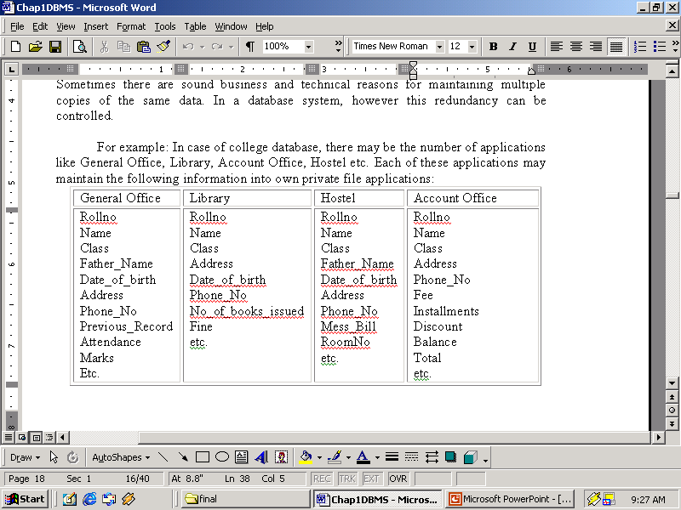
University Database in File Based System

Slide 15
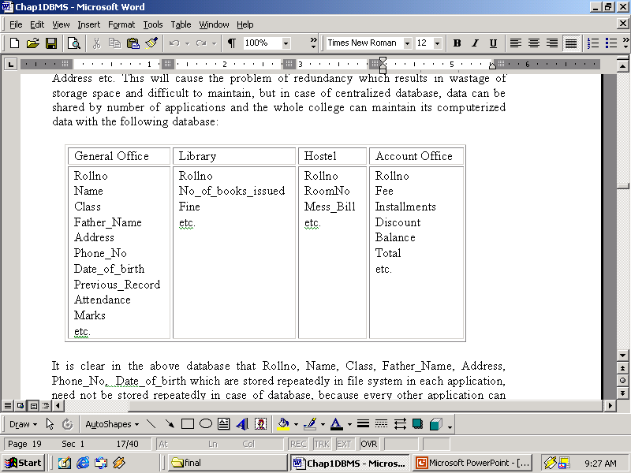
University Database in Database based System

Slide 16
Advantages of DBMS
Controlling Redundancy

Slide 17
Integrity can be enforced
Integrity of data means that data in database is always accurate, such that incorrect information cannot be stored in database.

Slide 18
Inconsistency can be avoided
When the same data is duplicated and changes are made at one site, which is not propagated to the other site, it gives rise to inconsistency and the two entries regarding the same data will not agree.

Slide 19
Other Advantages
Data can be shared
Providing Backup and Recovery
Standards can be enforced
Restricting unauthorized access
Solving enterprise requirement than individual requirement

Slide 20
Disadvantages of DBMS
Complexity
Size
Performance
Higher impact of a failure
Cost of DBMS
Additional Hardware costs
Cost of Conversion

Slide 21
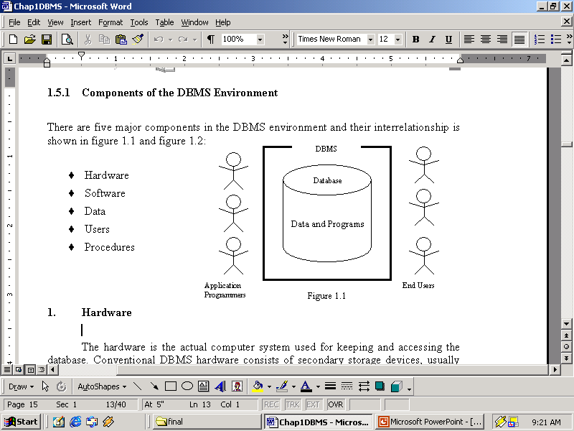
Components of the DBMS Environment
Hardware
Software
Data
Users
Procedures

